Slide 1
Starbucks in Quito, EC Finding the Best Location for the First Starbucks in Quito
by Andrés Borja
Submitted as part of IBM’s Data Science Specialization
Applied Data Science Capstone Project

Slide 2
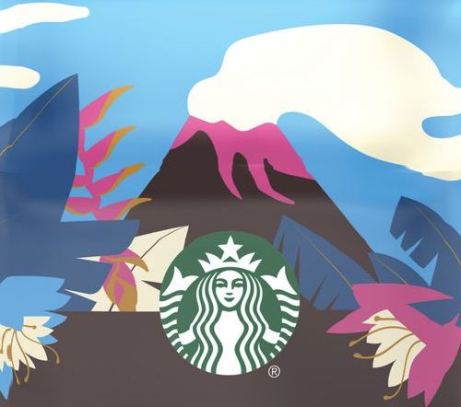
Background There are no Starbucks shops in Ecuador, not even in its capital city, Quito. Starbucks is interested in opening its first shop there but they would like to know what the best neighborhood or area in the city is the best for their enterprise to be successful.

Slide 3
Data
2 main data sources:
Quito’s municipality website: database with city’s neighborhoods and their geographical coordinates.
Foursquare API: venues and venue categories data.

Slide 4
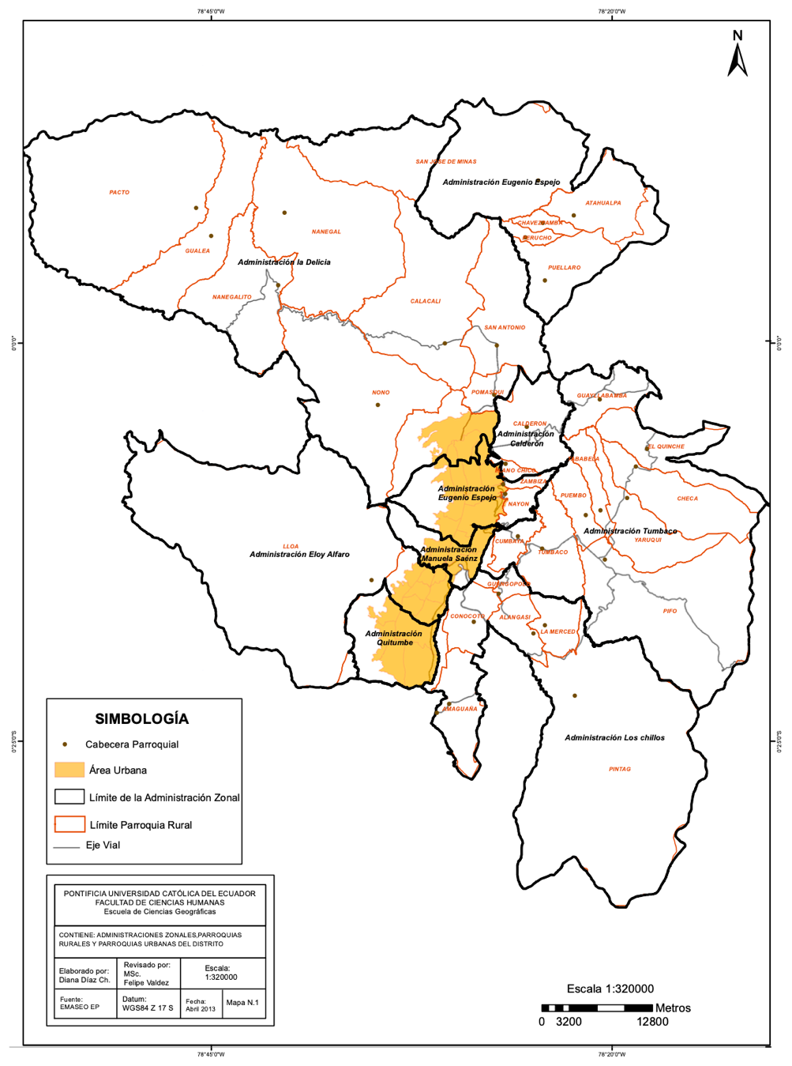
Quito’s neighborhoods
The Metropolitan District of Quito is huge. We decide to work only with neighborhoods included in its urban are, colored in yellow in this map.

Slide 5
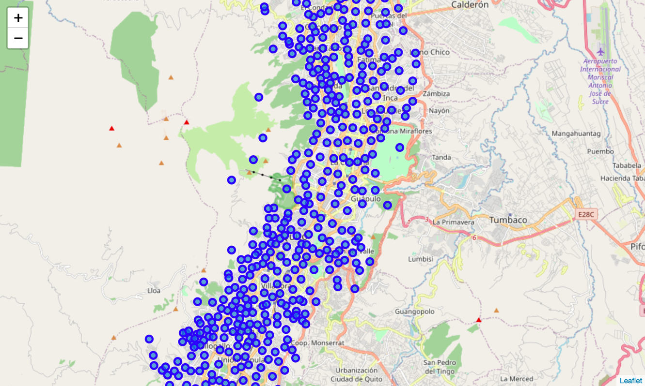
Mapping neighborhoods
We use Folium to create a map of Quito and we superimpose each of its urban neighborhoods with their coordinates.

Slide 6
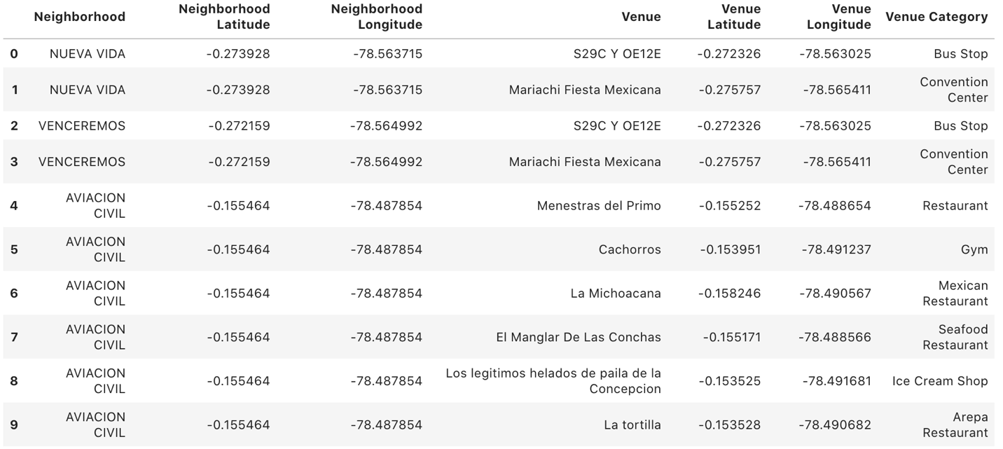
Exploring neighborhoods in Quito

Slide 7
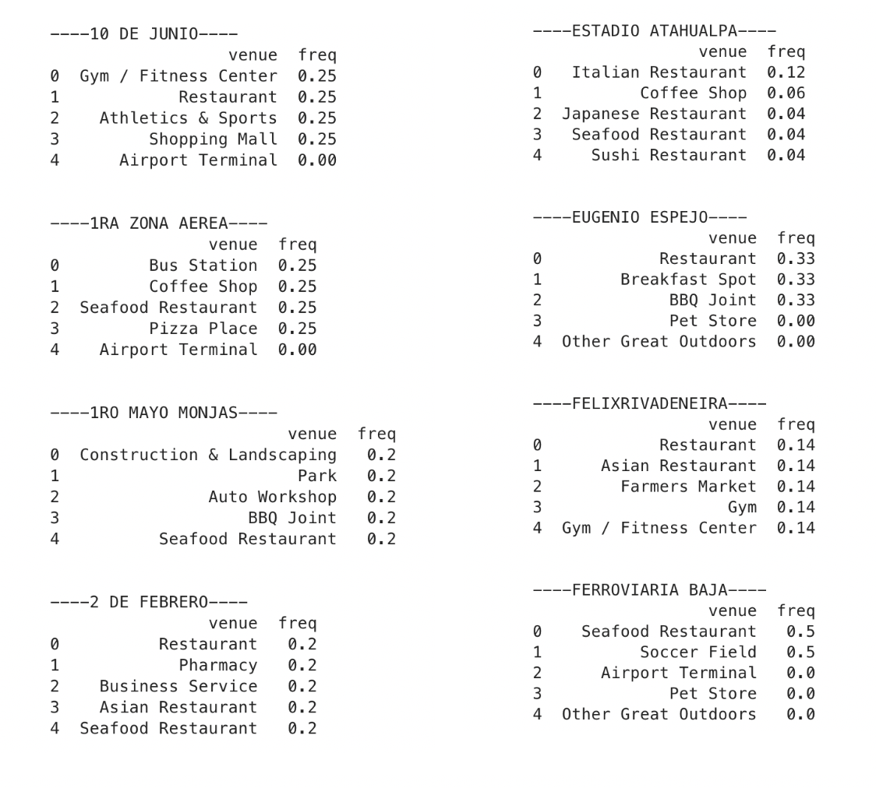
Analyzing each neighborhoods venue categories
We used one-hot encoding to explore the neighborhoods in terms of the frequency of occurrence of each venue category nearby.

Slide 8
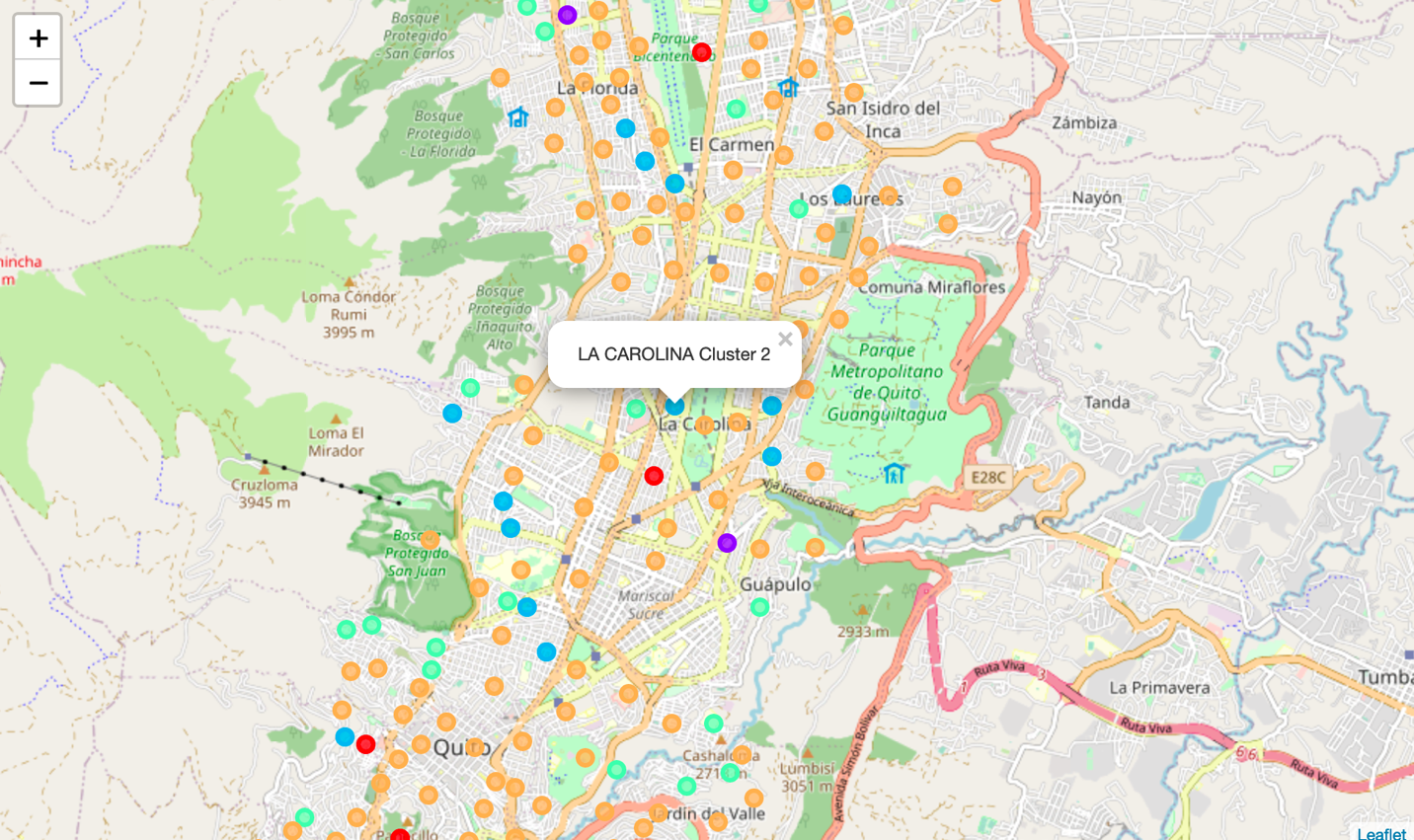
Clustering neighborhoods
The venues data was then trained using a K-means clustering algorithm to get the desired clusters to base the analysis on.
We created 5 clusters.

Slide 9
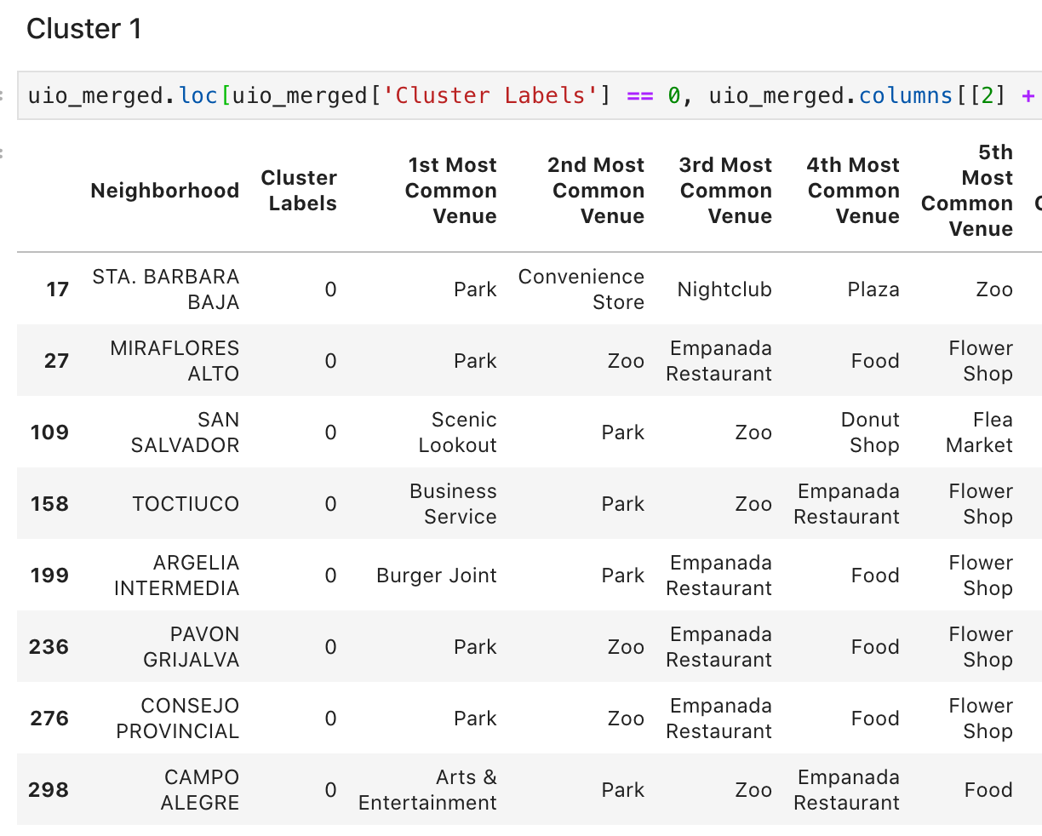
Cluster 1
This cluster's most common venues seem to be mainly parks, zoos and fields, so it would not be a good match for Starbucks.

Slide 10
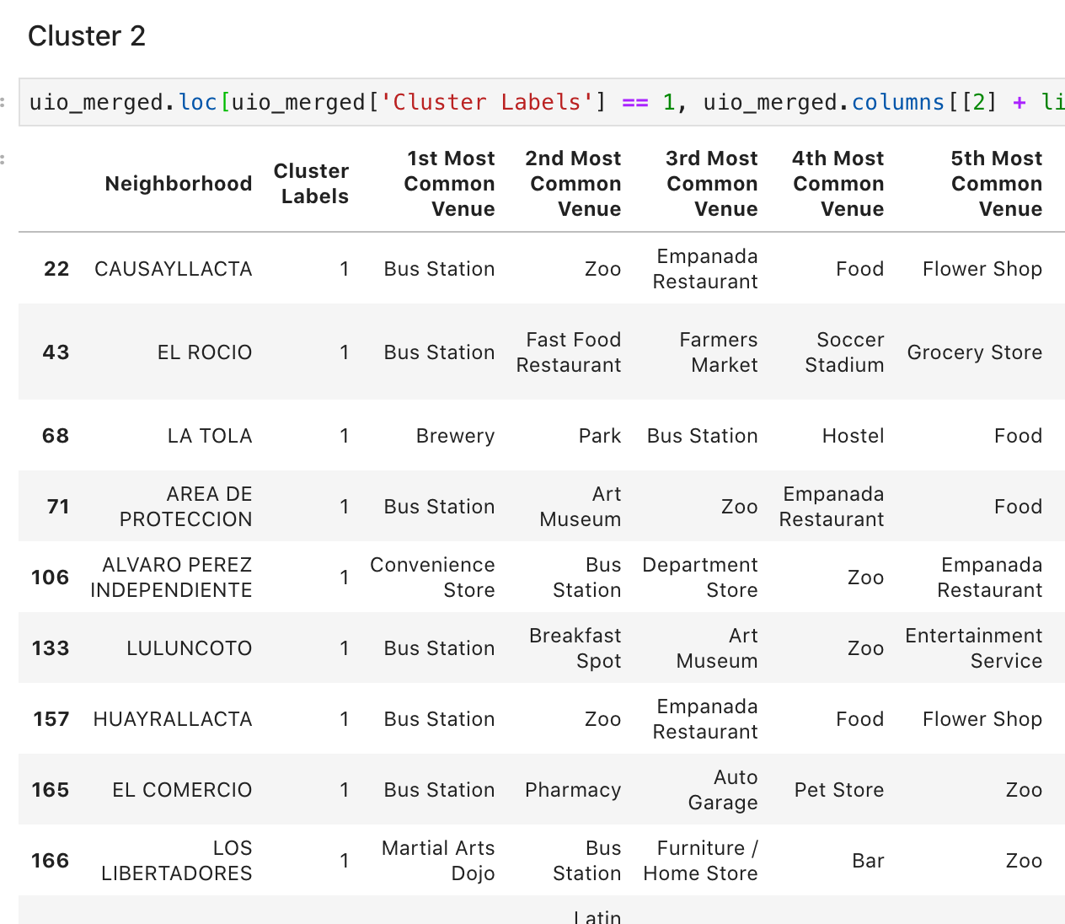
Cluster 2
Neighborhoods in cluster 2 seem to be surrounded by bus stations, mostly, as well as miscellaneous categories not related with the food and beverages industry. Again, not the best match for our Starbucks shop.

Slide 11
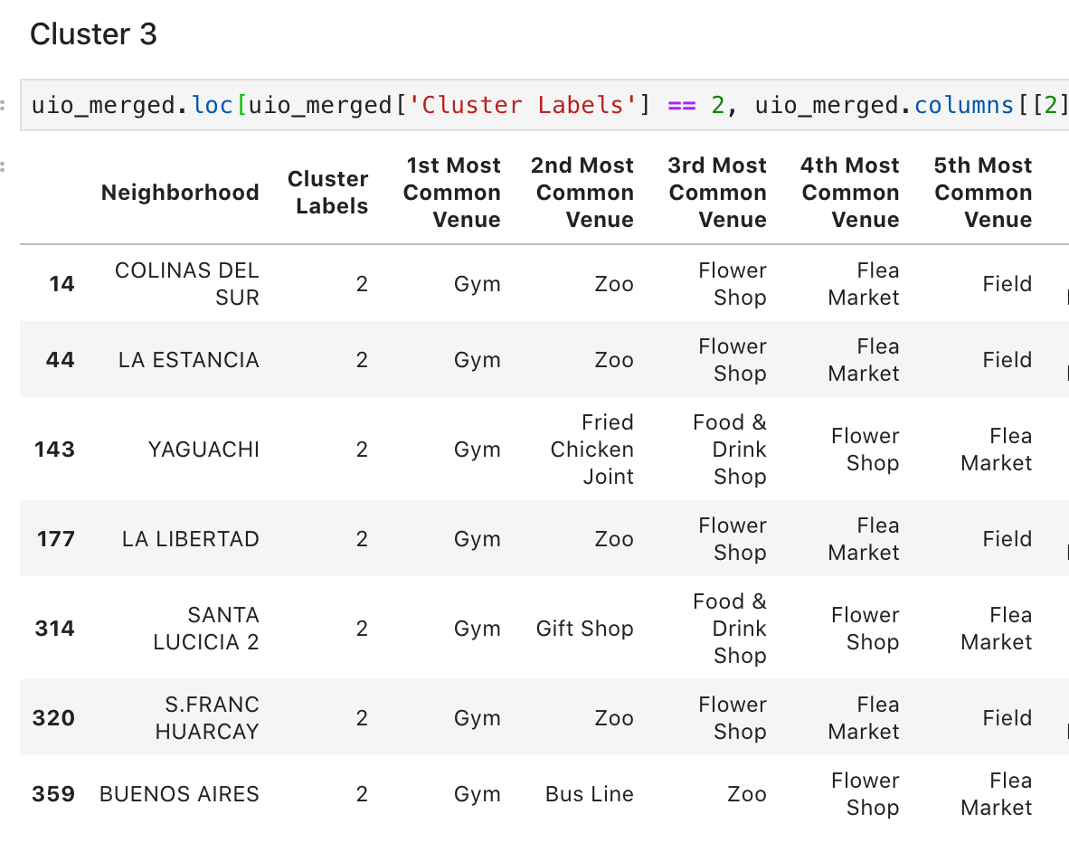
Cluster 3
Neighborhoods in cluster 3 seem to be surrounded by gyms, mostly, as well as zoos flea markets and flower shops. Again, not the best match for our Starbucks shop.

Slide 12
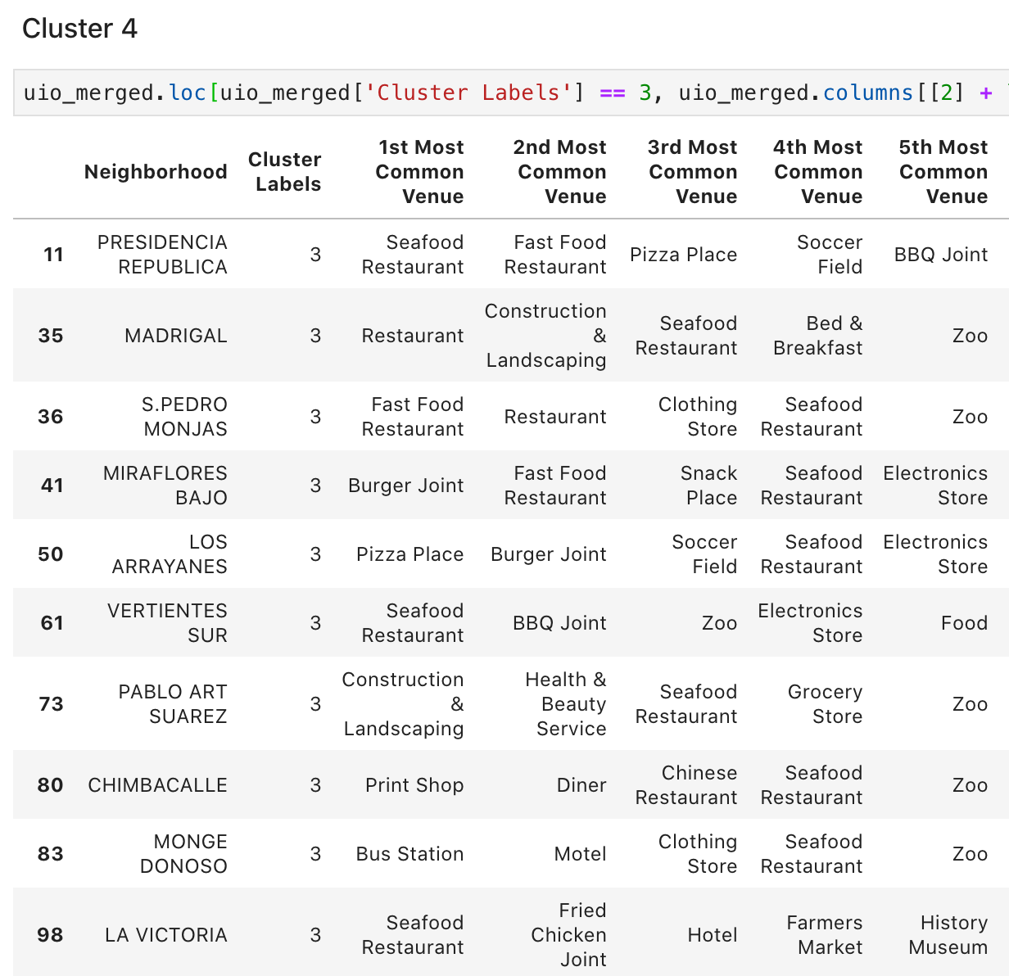
Cluster 4
This is the first cluster in which its neighborhoods seem to have a high variety of restaurants, which are related to a coffee shop. This cluster is a good candidate for Starbucks to consider when opening their first coffee shop in Quito.

Slide 13
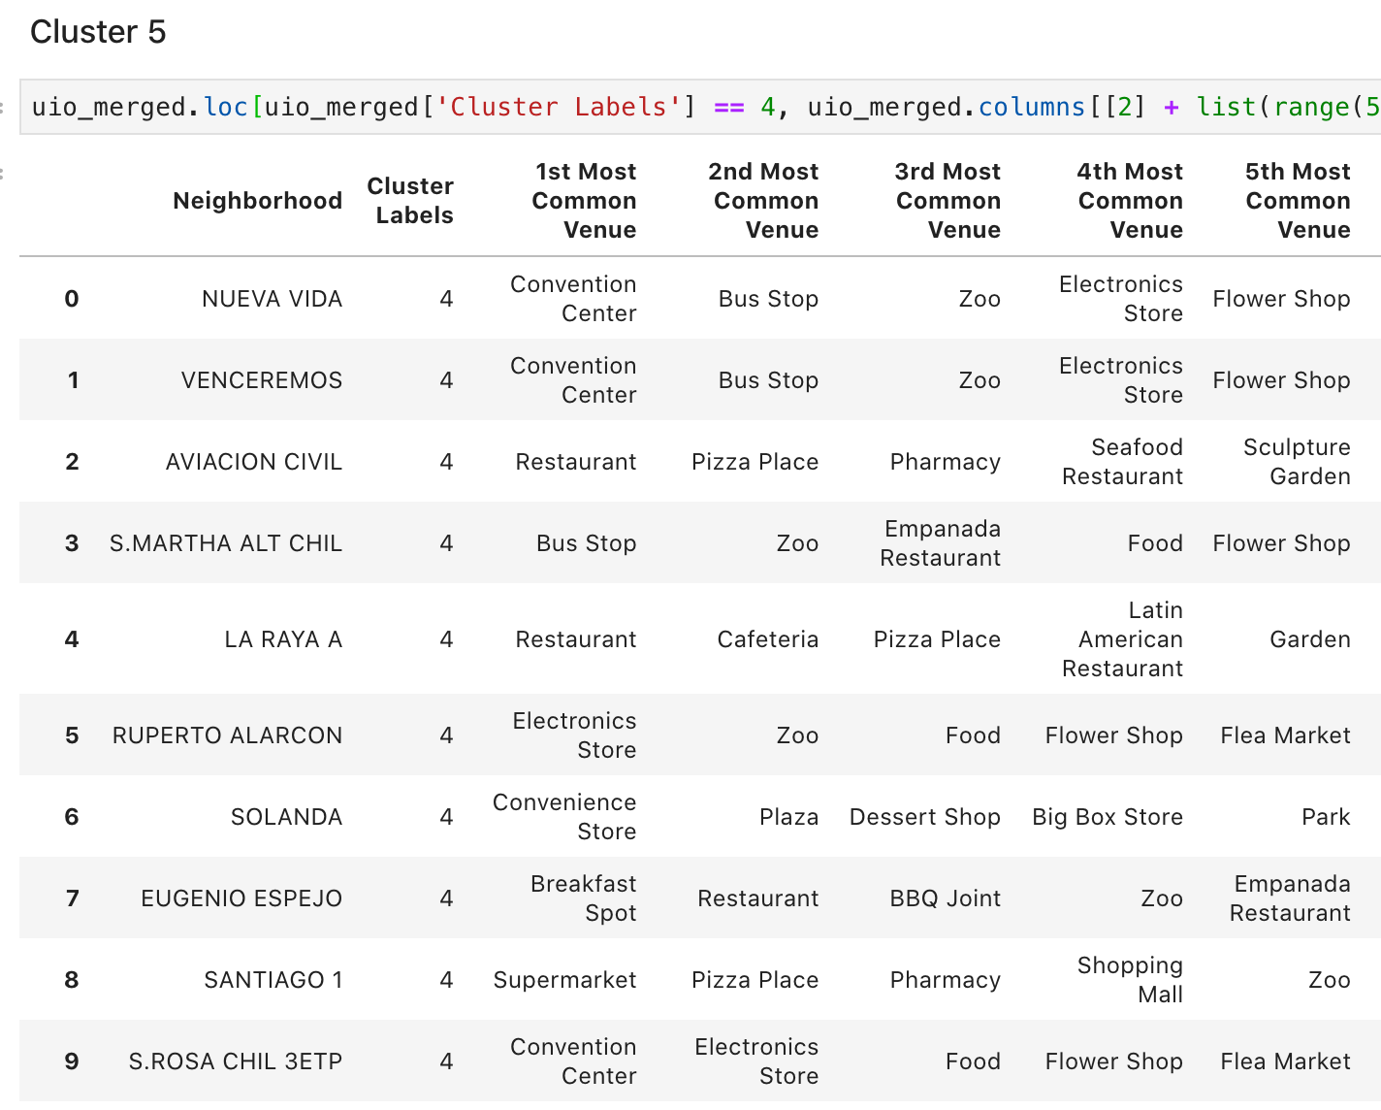
Cluster 5
This is the largest and least specific cluster we obtained. Its structure is hard to interpret, given that its most common venues don't seem to be related. It may or may not be a good fit for Starbucks’ ideal neighborhood.

Slide 14
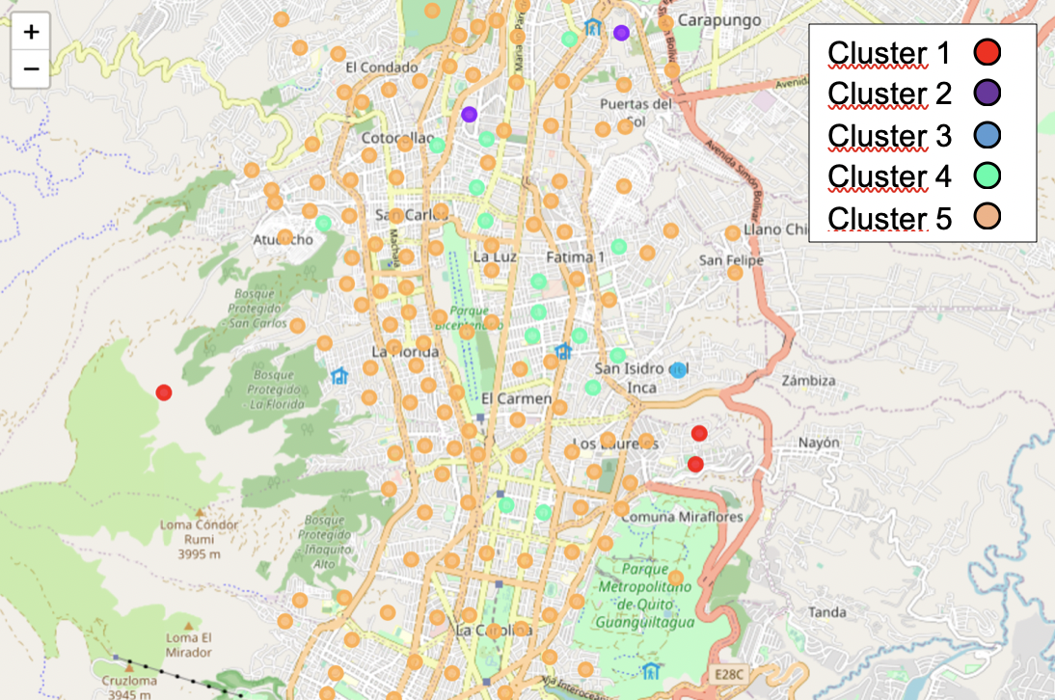
The winner? Cluster 4
The neighborhoods in this cluster are surrounded by venues very much related to the food and beverages industry. These areas are popullated with all sorts of restaurants and cafes, making them the ideal place for a world renowned coffee shop to succeed.

Slide 15
Discussion
Cluster 5 did not seem to be grouped by any discernible criteria or clear pattern of its venue categories.
We believe this is due to the fact that many of the neighborhoods did not have more than 1 or 2 venues in the established 500 meters radius.
We would recommend repeating the analysis by only using neighborhoods with at least 5 venues in their surroundings.

Slide 16


Thank you!

